Slide 1
Feeling helpless is exhausting. Here is an idea for at least
One Thing We Can Each Do
Make Last Friday’s Economic Blackout a Daily Practice
Why: With the Citizens United Ruling of 2010, the Supreme Court ruled that corporations are people, and, as such, they have the right to spend money as they wish in candidate elections. Source: NPR
What: Obviously, you’re not being asked to stop consuming altogether. You ARE being asked to consume as wisely as possible by spending your money as much as possible with corporations and small businesses that support democracy.
How:
Use an app such as Good Unites Us to find out where your money is currently going and to decide if it can be put to a more democratically supportive use with other entities.
Use a shopping list such as Shop Blue to guide your choices at a more granular level.
Encourage others to do the same!

Slide 2
Tools for Supporting Democracy Through Spending Wisely
Good Unites Us App
Shop Blue
List
GUU is available in the Apple App Store and in Google Play.
Users complete a profile, which shows them what their money supports.
Users can search for businesses and brands to see which businesses they’d like to patronize.
Shop Blue is a google docs form available in the Good Unites Us app, or it can be reached here.
Users can download the list and, while shopping, choose brands that align with their beliefs.

Slide 3
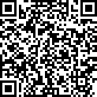
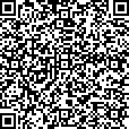
Tools for Supporting Democracy Through Spending Wisely
Good Unites Us App
Shop Blue
List
Apple App Store
Google Play App Store
Google Docs
"We will fail when we
fail to try." —Rosa Parks

